Slide 1
NaturalLI: Natural Logic Inference for Common Sense Reasoning Gabor Angeli and Christopher D. Manning EMNLP, 2014
Hangfeng He (hangfeng@seas.upenn.edu)
March 11, 2019

Slide 2
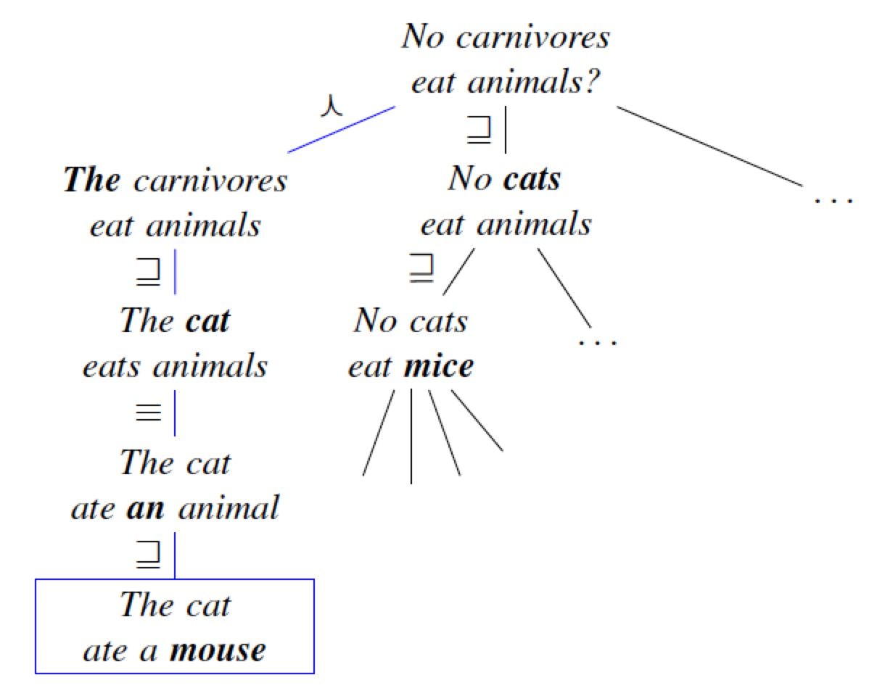
Problem
Common Sense Reasoning: Database Completion
Given a database of true facts
The task is to predict whether an unseen fact is true and should belong in the database
It is an exploratory task
An Example
Query: “no carnivores eat animals”
Find a premise in the database to prove or disprove the query

Slide 3
Motivation
Challenges
Natural Logic inference: a proof system built on the syntax of human language
Maintain high recall, particularly for large scale open-domain tasks
Generalize to arbitrary relations
Problems in Previous Works
Prior work on Natural Logic has focused on inferences from a single relevant premise , making use of only formally valid inferences
Standard IR methods easily miss small but semantically important lexical differences
Many methods require explicitly modeling either the database, the query, or the both in a formal meaning representation
Question
Can we have an inference system over unstructured text for a large set of candidate premises without aligning to any particular premise ?

Slide 4
Contents:
Introduction
MacCartney’s Natural Logic
Inference as a Finite State Machine
Inference as Search
Experiments
Discussion

Slide 5
Contributions of this work
Contributions in Database Completion
It allows unstructured text as the input database without any assumptions about the schema or domain of the text
It proposes Natural Logic for inference, rather than translating to a formal logic syntax
Contributions in Computational Natural Logic
Operates over a very large set of candidate premises simultaneously
Do not require explicit alignment between a premise and the query
Allow imprecise inferences at an associated cost learned from data

Slide 6
MacCartney’s Natural Logic
Based on
Theoretical work on Natural Logic and Monotonicity Calculus (van Benthem, 1986; Valencia, 1991)
NatLog system (MacCartney and Manning, 2007; 2008; 2009)
Components
Lexical Relations
Monotonicity and Polarity
Proof by Alignment

Slide 7
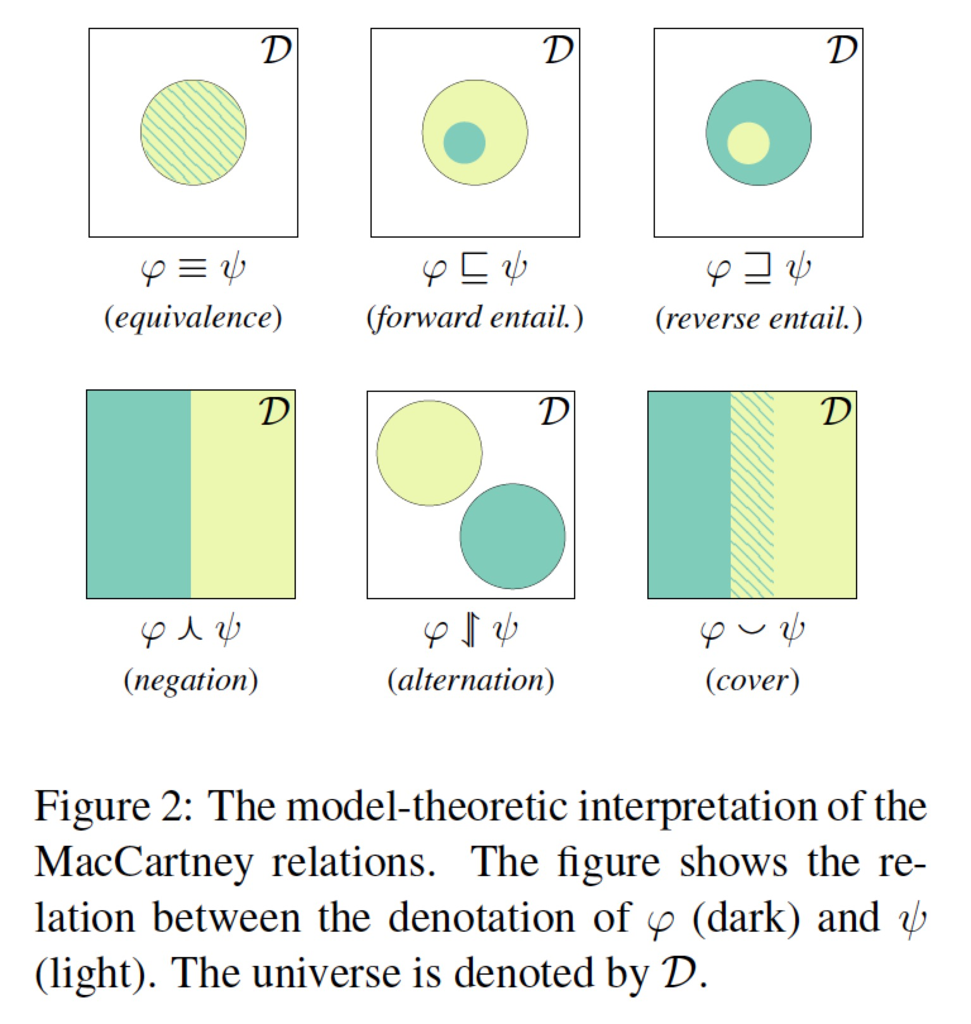
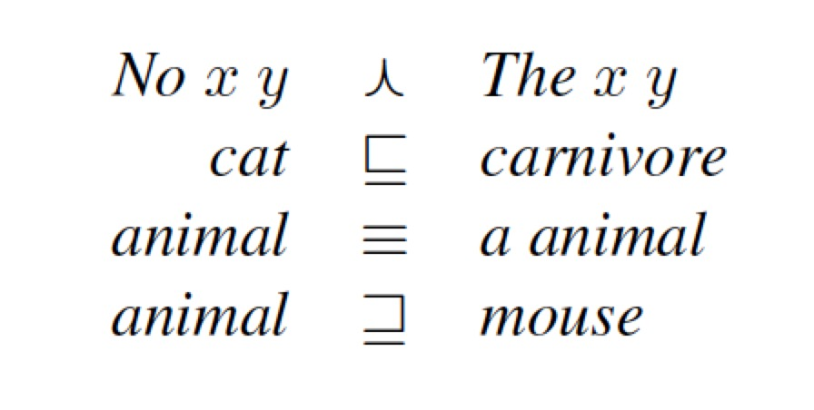
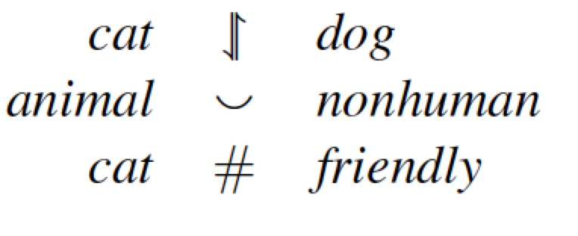
MacCartney’s Natural Logic
Lexical Relations
Seven set-theoretic relations
#: completely uninformative relation

Slide 8
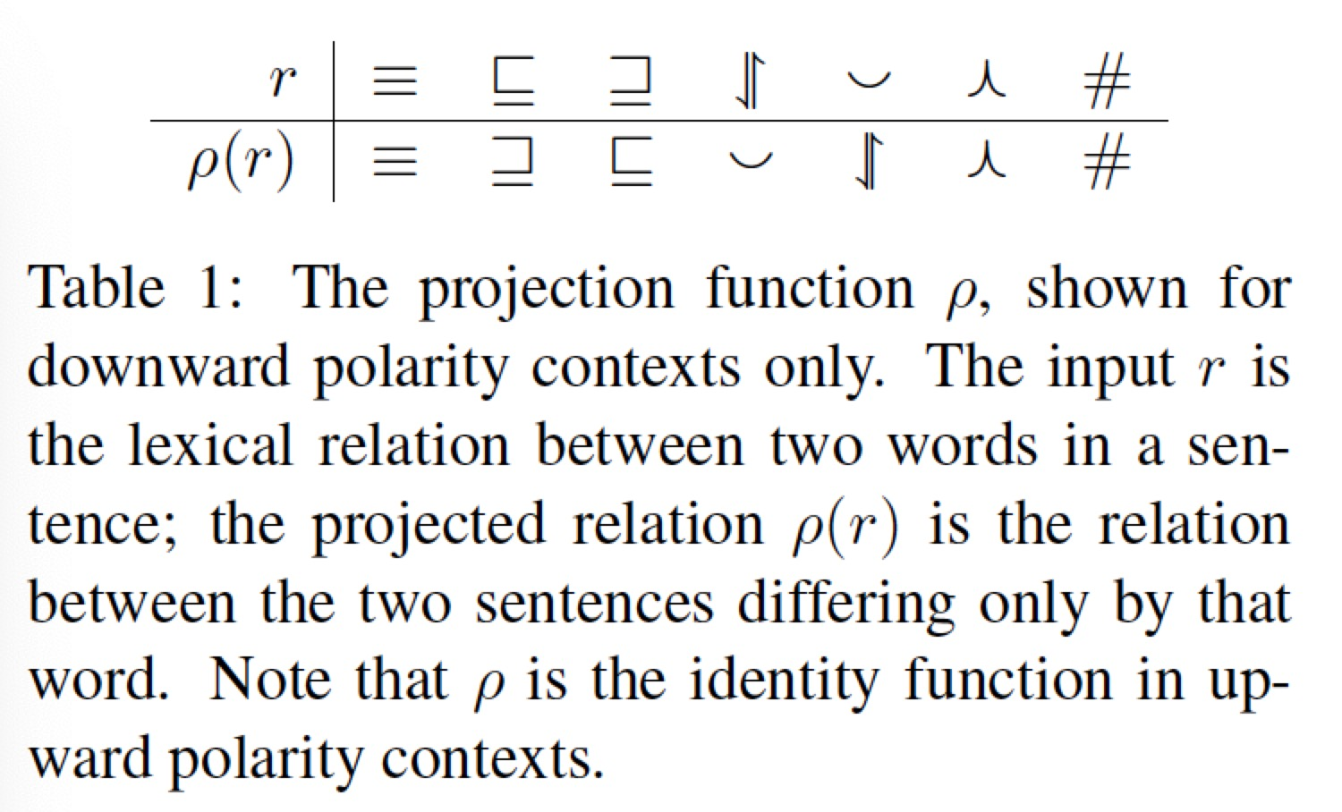
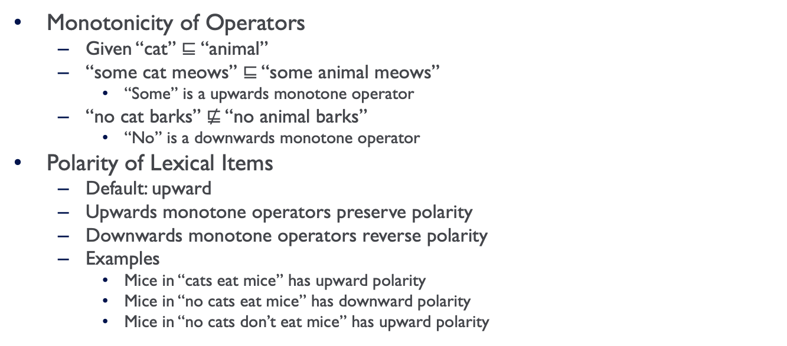
MacCartney’s Natural Logic
Monotonicity of Operators
Given “cat” $⊑$“animal”
“some cat meows” ⊑ “some animal meows”
“Some” is a upwards monotone operator
“no cat barks” ⋢ “no animal barks”
“No” is a downwards monotone operator
Polarity of Lexical Items
Default: upward
Upwards monotone operators preserve polarity
Downwards monotone operators reverse polarity
Examples
Mice in “cats eat mice” has upward polarity
Mice in “no cats eat mice” has downward polarity
Mice in “no cats don’t eat mice” has upward polarity

Slide 9
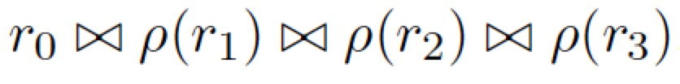
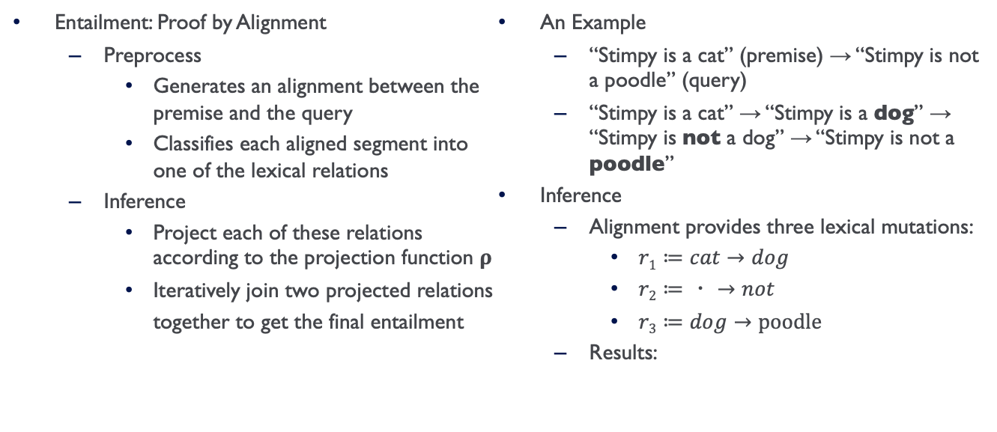
MacCartney’s Natural Logic
Entailment: Proof by Alignment
Preprocess
Generates an alignment between the premise and the query
Classifies each aligned segment into one of the lexical relations
Inference
Project each of these relations according to the projection function 𝛒
Iteratively join two projected relations together to get the final entailment
An Example
“Stimpy is a cat” (premise) → “Stimpy is not a poodle” (query)
“Stimpy is a cat” → “Stimpy is a dog” → “Stimpy is not a dog” → “Stimpy is not a poodle”
Inference
Alignment provides three lexical mutations:
$r1≔cat→dog$
$r2≔・→not$
$r3≔dog→poodle$
Results:

Slide 10
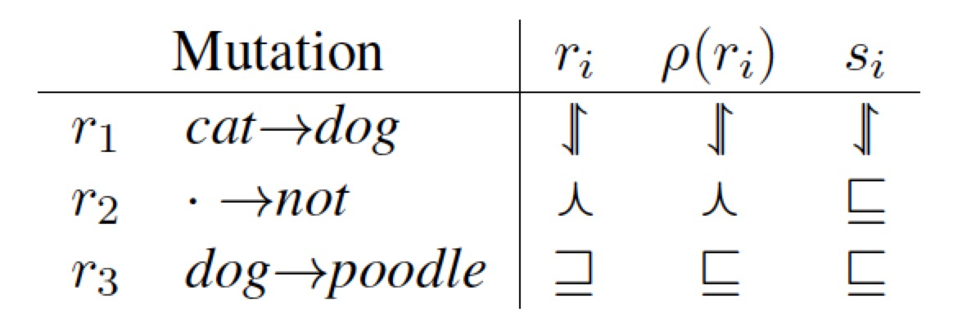
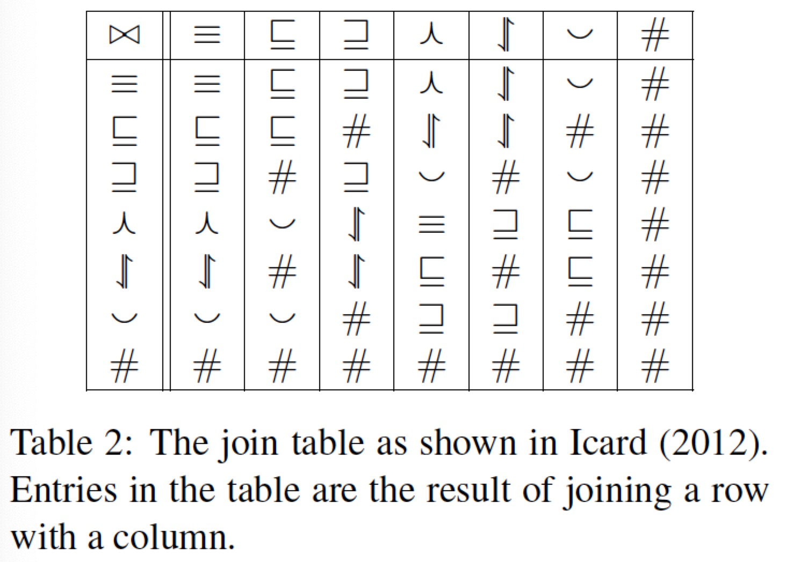
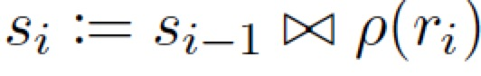
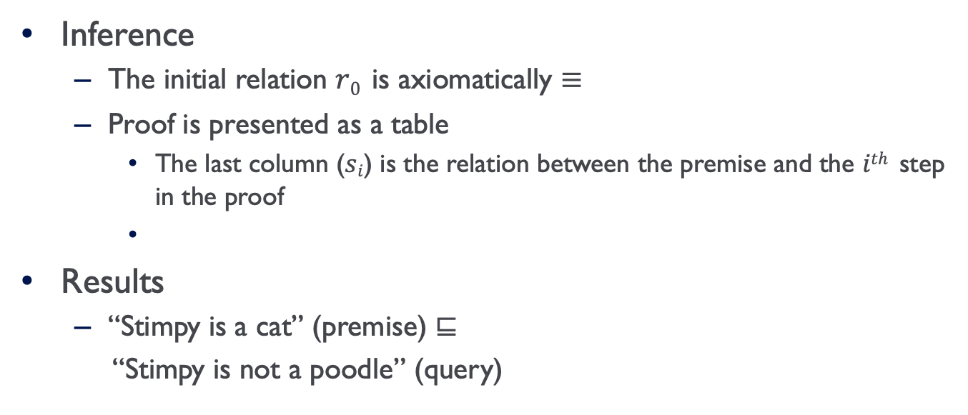
Proof By Alignment
Inference
The initial relation $r0$ is axiomatically ≡
Proof is presented as a table
The last column ($si$) is the relation between the premise and the $ith$ step in the proof
Results
“Stimpy is a cat” (premise) ⊑
“Stimpy is not a poodle” (query)

Slide 11
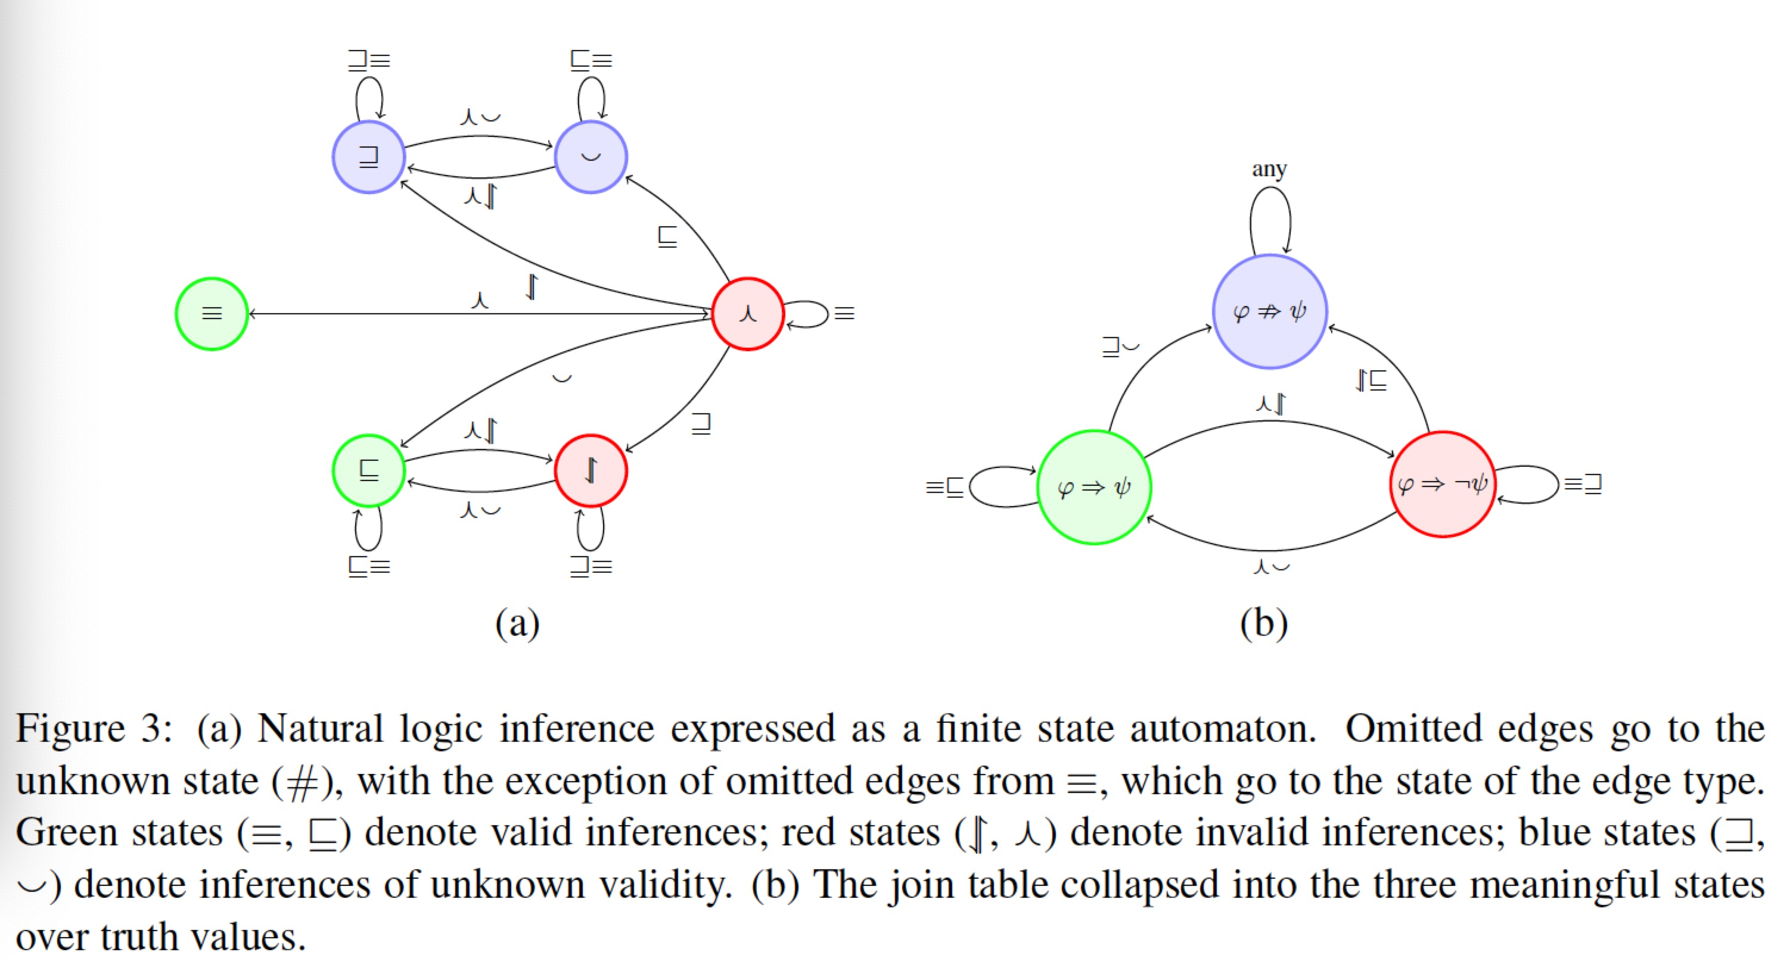
Inference as a Finite State Machine

Slide 12
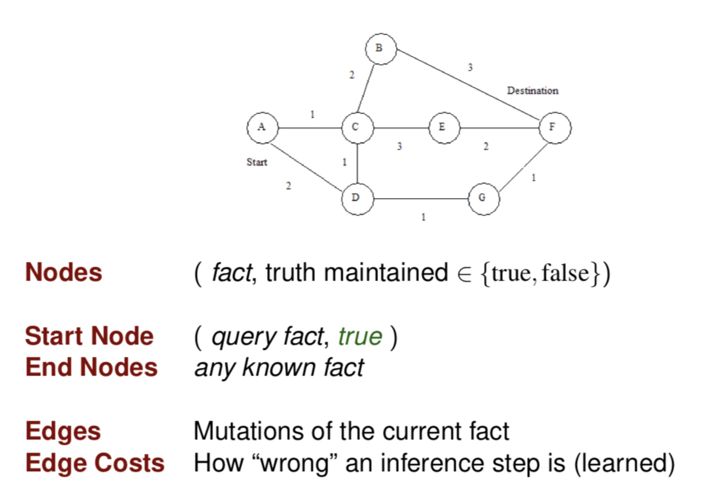
Inference As Search

Slide 13
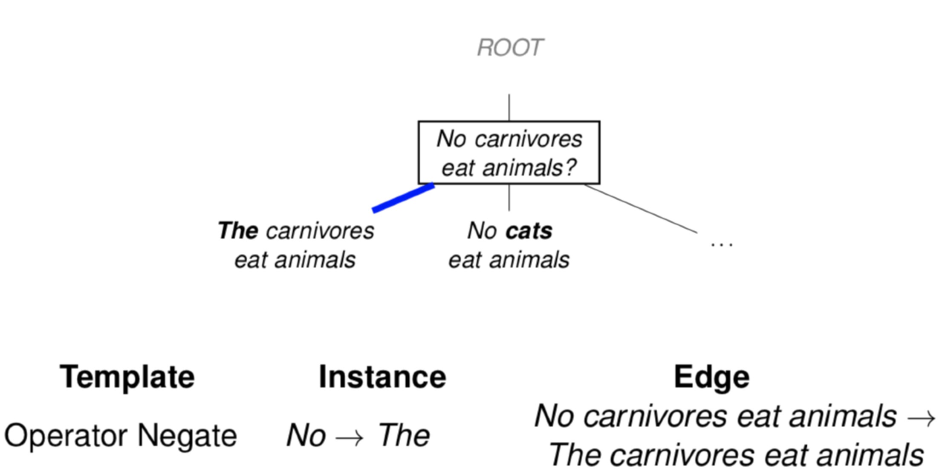
An Example Search

Slide 14
An Example Search

Slide 15
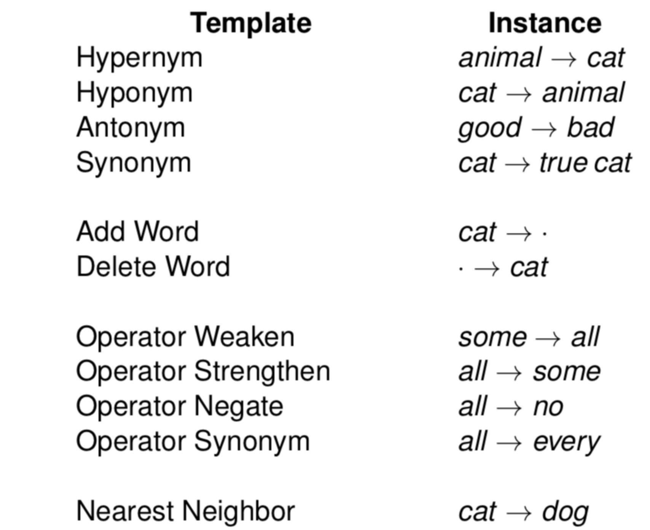
Edge Templates

Slide 16
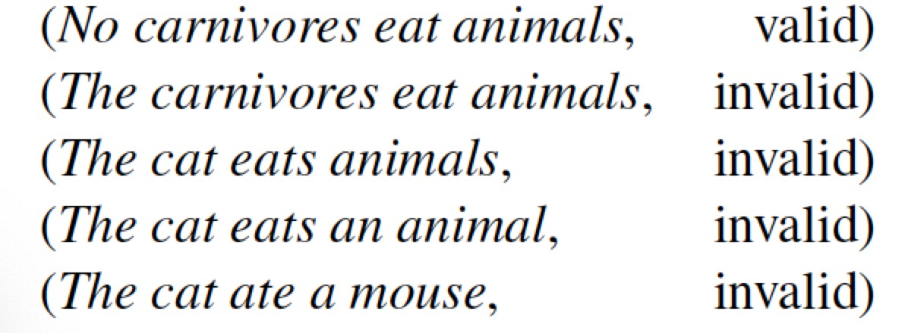
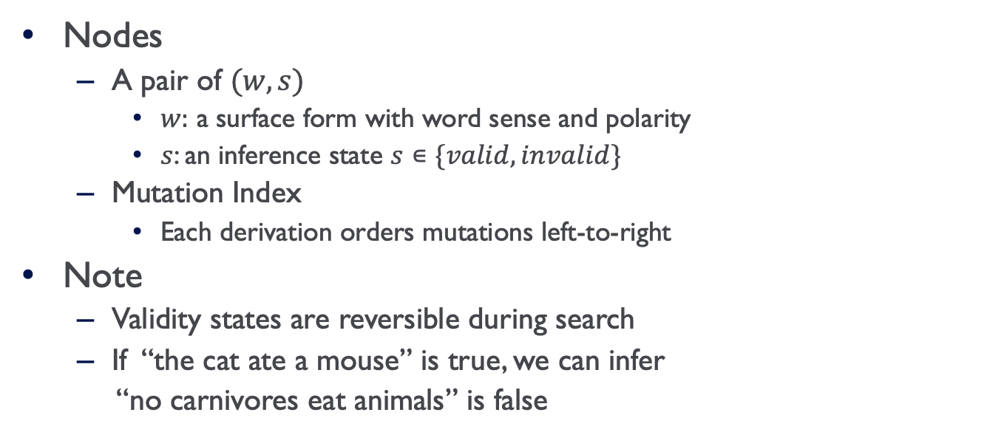
Inference As Search
Nodes
A pair of $(w, s)$
$w:$ a surface form with word sense and polarity
$s$: an inference state $s∊\{valid, invalid\}$
Mutation Index
Each derivation orders mutations left-to-right
Note
Validity states are reversible during search
If “the cat ate a mouse” is true, we can infer
“no carnivores eat animals” is false

Slide 17
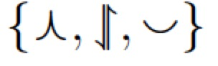
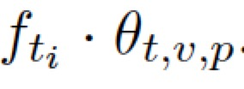
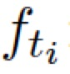
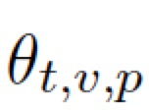
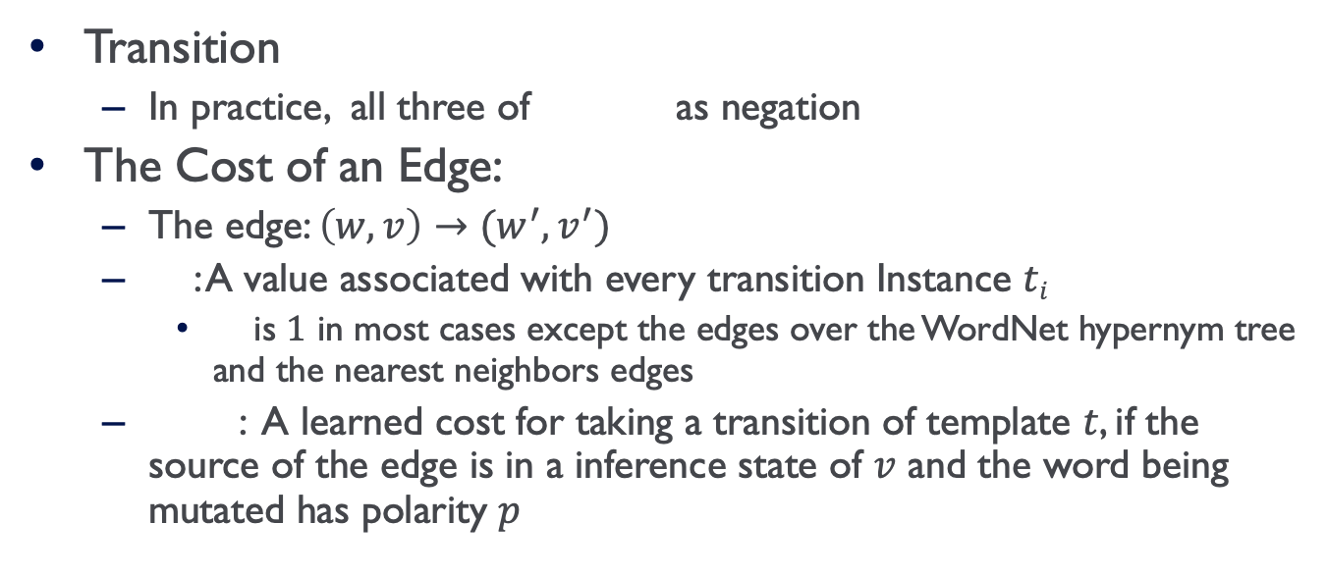
Inference As Search
Transition
In practice, all three of as negation
The Cost of an Edge:
The edge: $\left(w, v\right)→(w^{′}, v^{′})$
: A value associated with every transition Instance $ti$
is $1$ in most cases except the edges over the WordNet hypernym tree and the nearest neighbors edges
: A learned cost for taking a transition of template $t$, if the source of the edge is in a inference state of $v$ and the word being mutated has polarity $p$

Slide 18
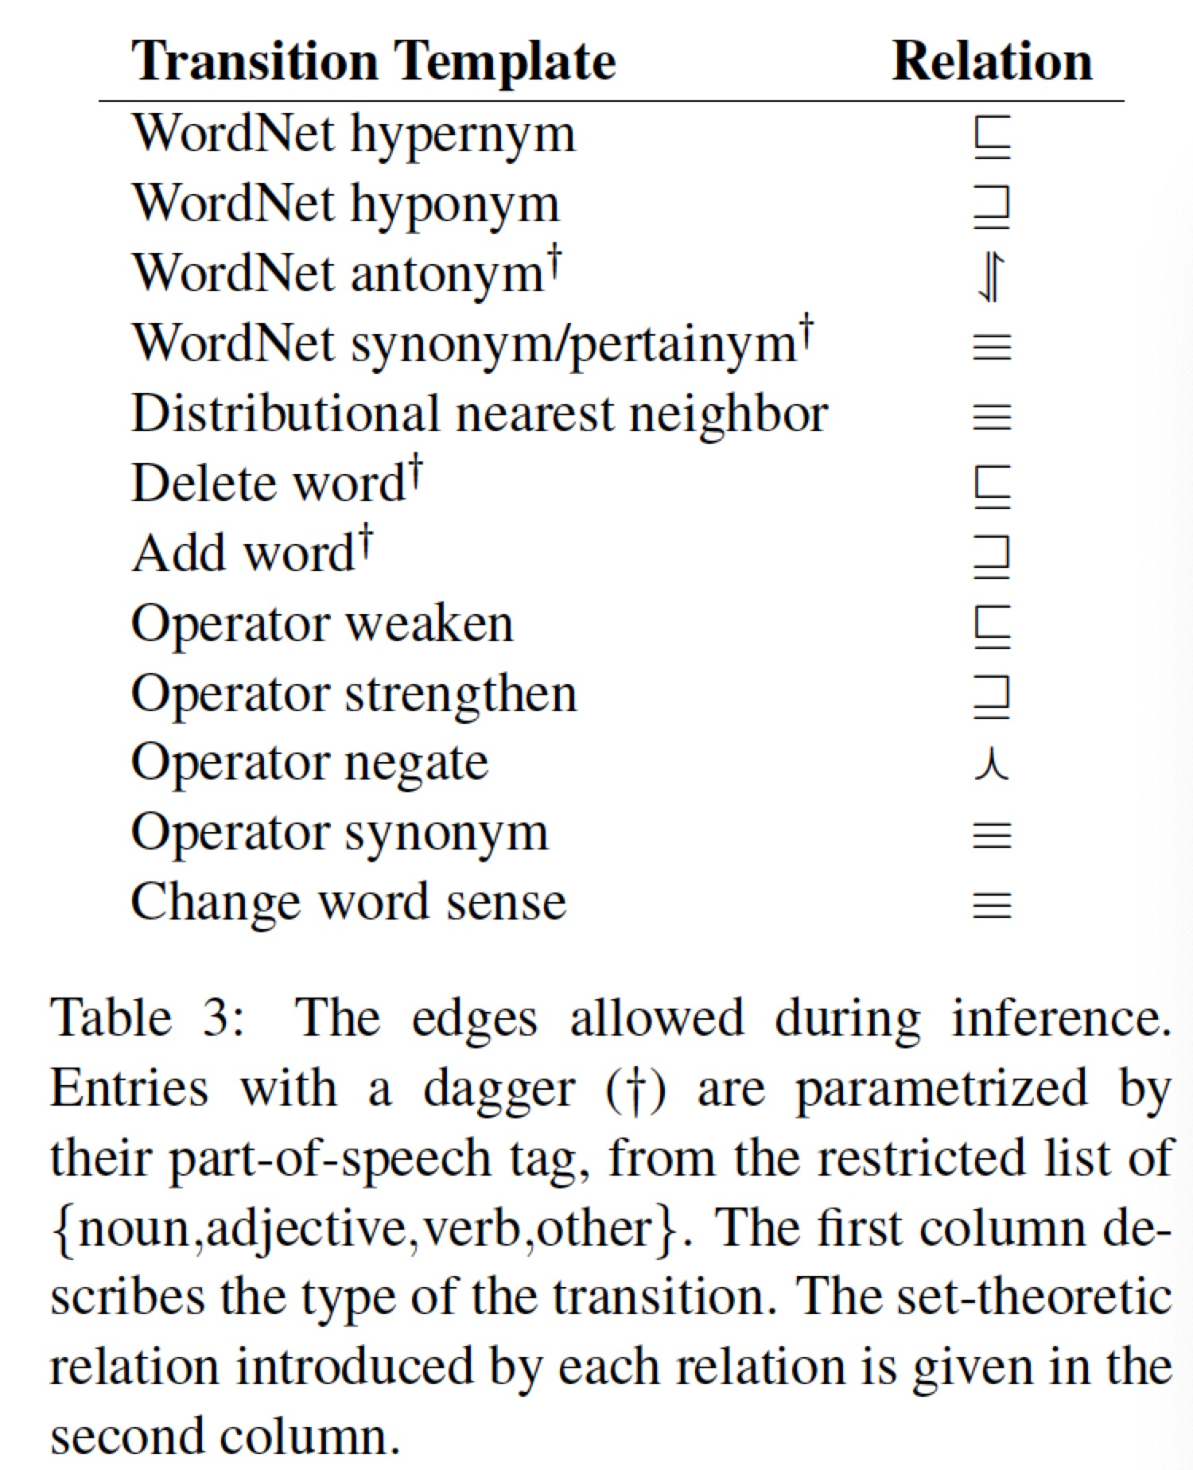
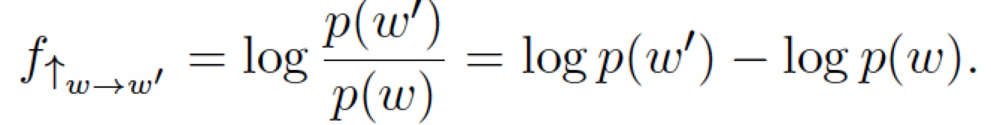
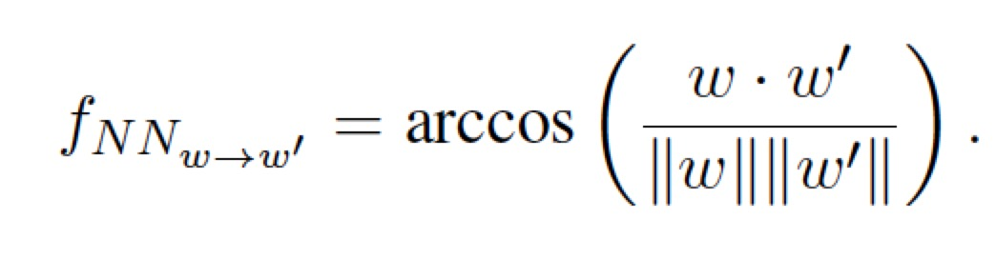
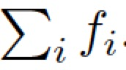
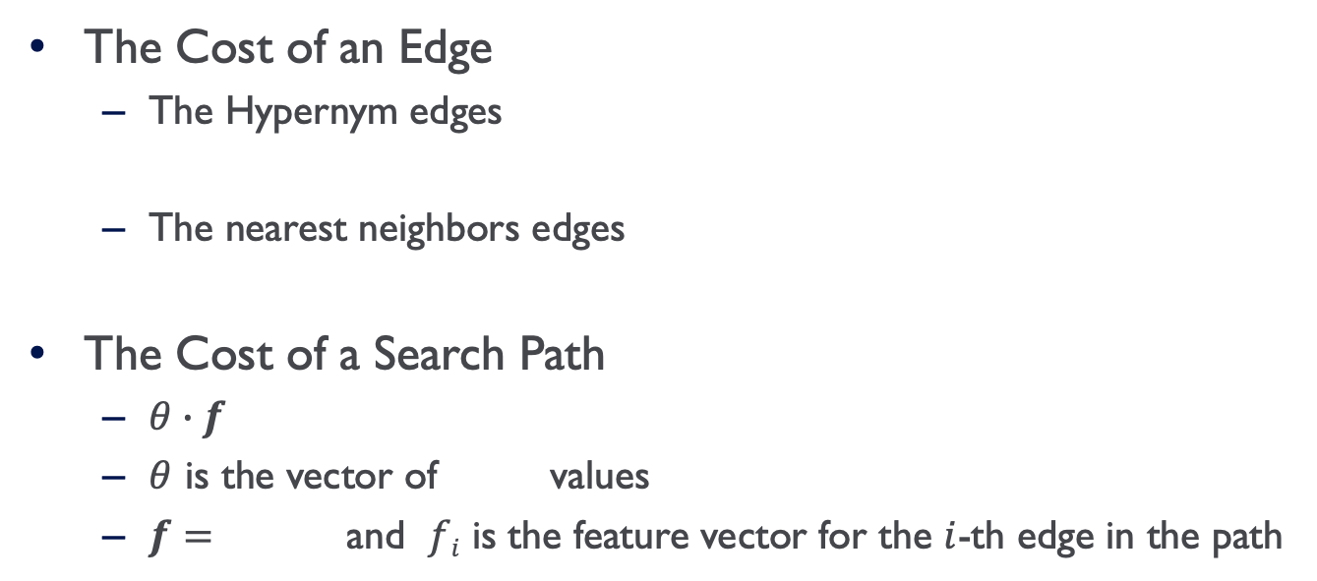
Transition
The Cost of an Edge
The Hypernym edges
The nearest neighbors edges
The Cost of a Search Path
$θ∙f$
$θ$ is the vector of values
$f=$ and $fi$ is the feature vector for the $i$-th edge in the path

Slide 19
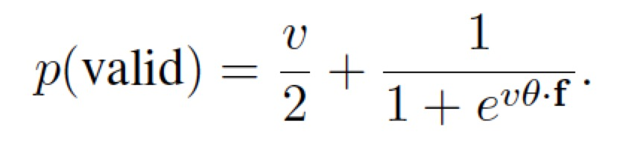
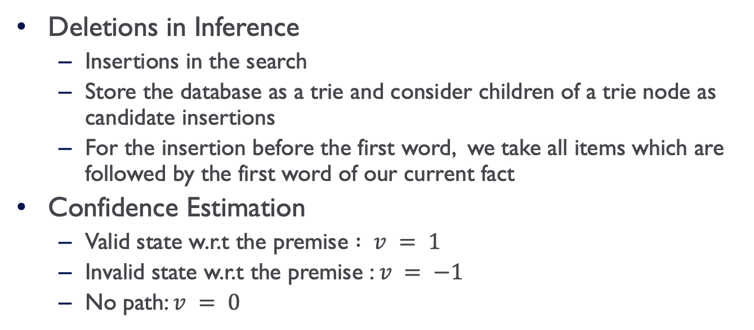
Inference As Search
Deletions in Inference
Insertions in the search
Store the database as a trie and consider children of a trie node as candidate insertions
For the insertion before the first word, we take all items which are followed by the first word of our current fact
Confidence Estimation
Valid state w.r.t the premise $: v = 1$
Invalid state w.r.t the premise : $v = −1$
No path: $v = 0$

Slide 20
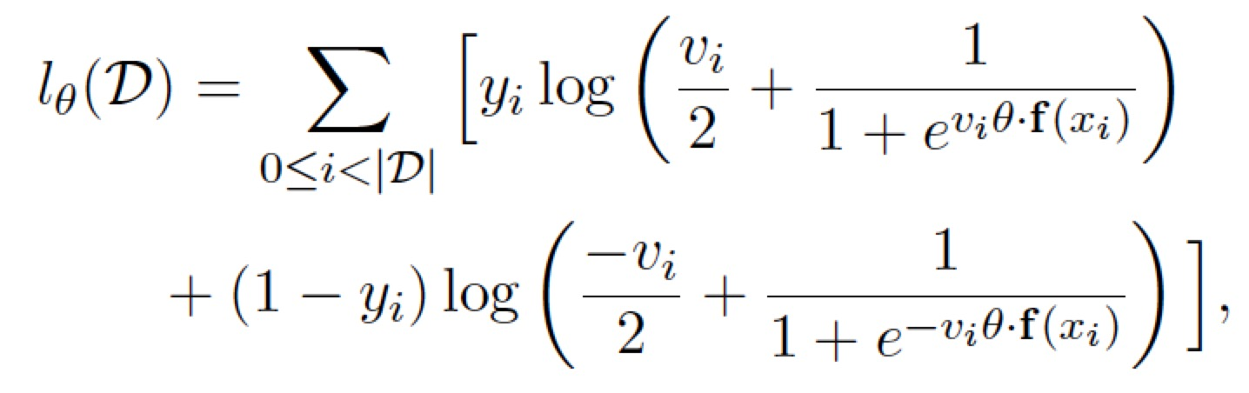
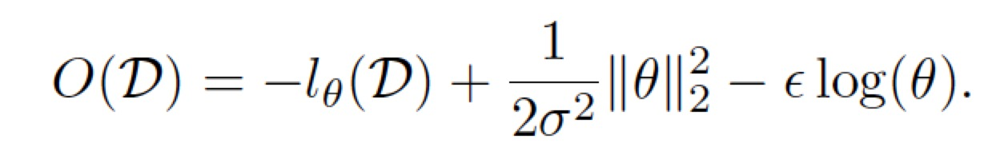
Learning Transition Costs
Objective Function
Positive Feedback Loop
Search the best path
Update the parameters

Slide 21
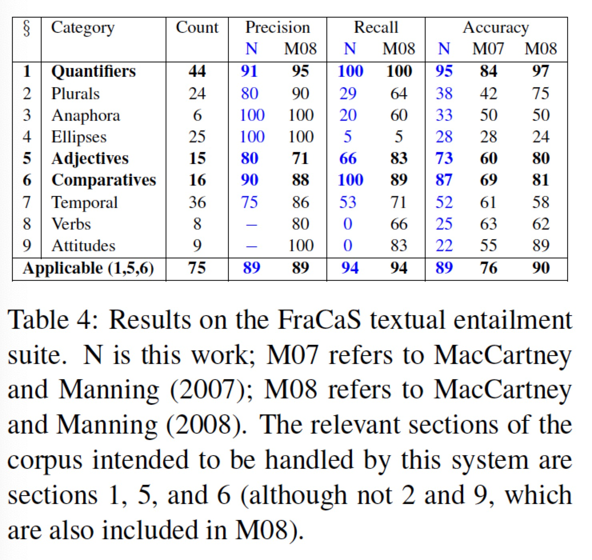
Experiments: Textual Entailment
Unfair Comparison
It cannot appeal to the premise when constructing the search
The derivation process itself does not have access to the full parse tree of the candidate fact

Slide 22
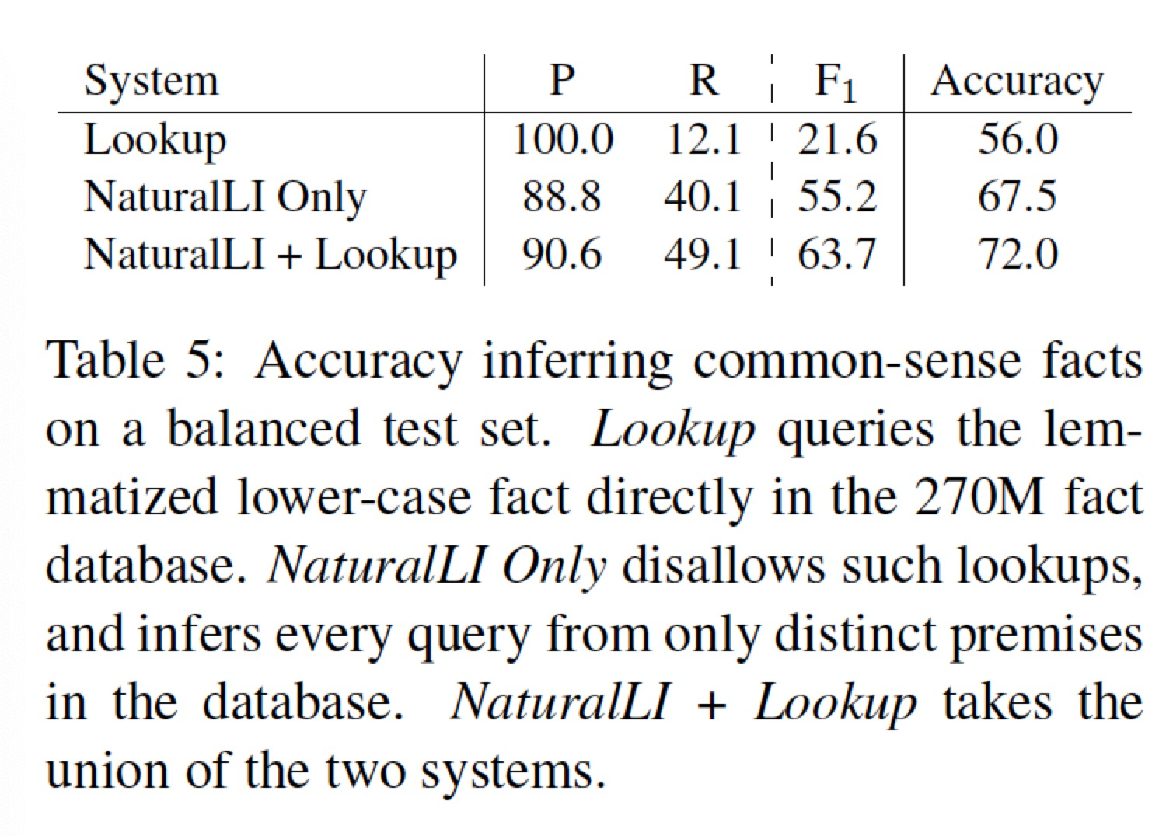
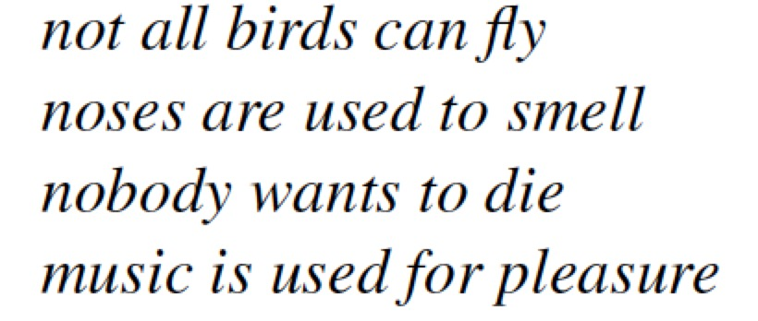
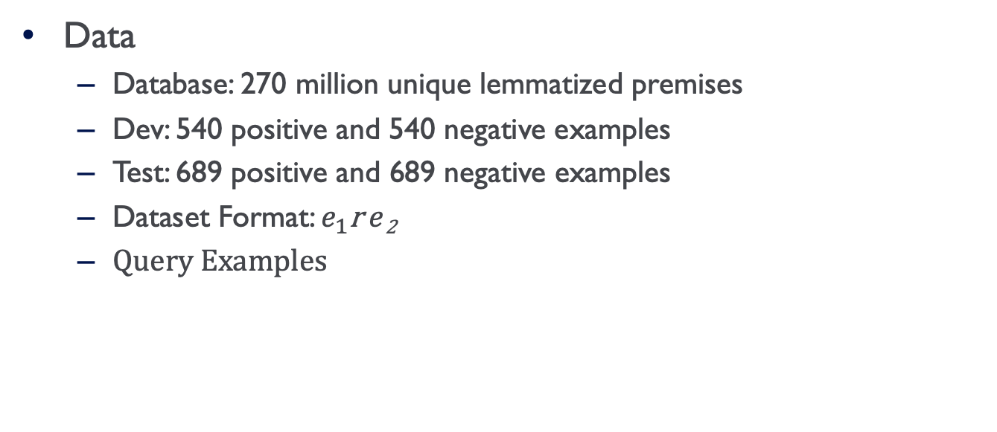
Experiments: Common Sense Reasoning
Data
Database: 270 million unique lemmatized premises
Dev: 540 positive and 540 negative examples
Test: 689 positive and 689 negative examples
Dataset Format: $e_{1}$r $e$₂
Query Examples

Slide 23
Discussion
Take-aways
NaturalLI: an inference system over unstructured text to infer common sense facts based on a large set of premises
Use Natural Logic for textual entailment
Search from the query rather than extend knowledge bases
Main Shortcomings
The lookup baseline is weak
Compare with more baselines
Database with triple format premises is limited
Experiment on more complicated dataset

